Slide 1
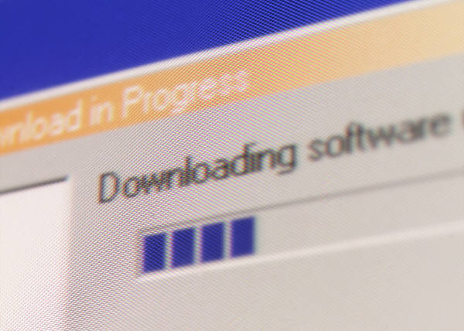
Advantages and Disadvantages of Open source Software
By: Pamela Wiggins and Mandi Aubrey

Slide 2

Objectives of Presentation:
To identify and define OSS
To demonstrate knowledge of the OSS movement
To articulate advantages and disadvantages of OSS
To suggest tips for libraries wishing to make the switch to OSS

Slide 3
What is Open Source Software?
According to AlMarzouq et. al, OSS refers to software “that anyone can freely distribute, analyze, and modify while complying with certain criteria.” (From “Open Source: Concepts, Benefits, and Challenges)
Open source software is software whose source code is available for modification or enhancement by anyone.

Slide 4
The OSS MOVEMENT
By 1998…
Open Source
(instead of free software because of negative stigma in the corporate world)
By the mid-1990’s reduced costs, increased performance of personal computers together with the rapid growth of the World Wide Web all contributed to the growth of online development communities. (Think Linux and Apache here)

Slide 5
How OSS Relates to Libraries
Aim of OSS:
Philosophy of Library:
To let the product be more:
Understandable
Reliable
Modifiable
Accessible
Duplicatable
Openness
Collaboration
Intellectual freedom
Excellent user experience
Learning environment

Slide 6
Examples of OSS Projects
Web Publishing
And Servers
Wordpress
Integrated Library
Systems
Koha
Digital Library
Dspace
Email and Web Browsing
Firefox
Evergreen
Greenstone
Fedora
Drupal
Open Office
GIMPshop
PDF Creator
Thunderbird
Apache
Linux
RIP
Gnome

Slide 7
Advantages of OSS:
Lower costs??
No vendor lock-in
Increased potential of adaptation and innovation
Highly interactive if you wish to network with greater community
Reduction in time and effort if you just want to be a consumer
Quality of software
Security
Easier to locate and fix “bugs”
Creativity

Slide 8
Disadvantages of OSS:
Not as user friendly as commercial software
Adequate support from IT department?
OSS is a work-in-progress
Lack of technical ability
Fear of the unknown
Institutional and organizational procurement process affecting the decision making process

Slide 9
Suggestions for Libraries considering OSS
Evaluate whether your library has the right tech skills
Talk with professional friends who have experience with OSS and consider their recommendations
Consider pragmatic limitations
Ensure availability of standards
Check out the version history
Ultimately, determine if OSS helps you be a more resourceful library

Slide 10
Comments?
Questions?

